Slide 1
International Financial Accounting
Dr Sean Power, ACA

Slide 2
Session 5
Notes to the financial statements

Slide 3
Session 5: Notes
Introduction to Notes to the financial statements
Operating segments (IFRS 8)
Related party disclosures (IAS 24)

Slide 4
Introduction to notes

Slide 5
Introduction
A wealth of information about the company – often ignored
You will have to scrutinize the Notes for your group project
For example, following info disclosed:
Accounting policy descriptions – Note #1
Tells you how figures prepared, assumptions made, estimates, etc
Contingent liabilities & contingent assets – we talked about IAS 37 in Session 2
Segmental information (IFRS 8)
Related party disclosures (IAS 24)

Slide 6
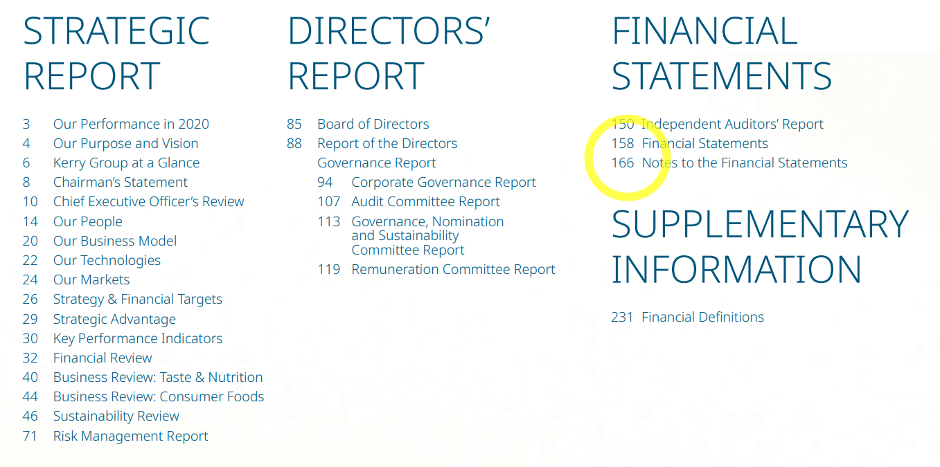
Where to find the Notes

Slide 7
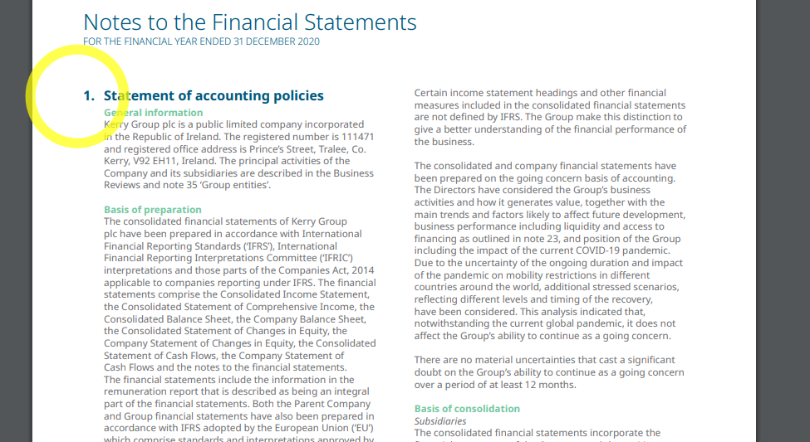
Note #1: Accounting Policies Note

Slide 8
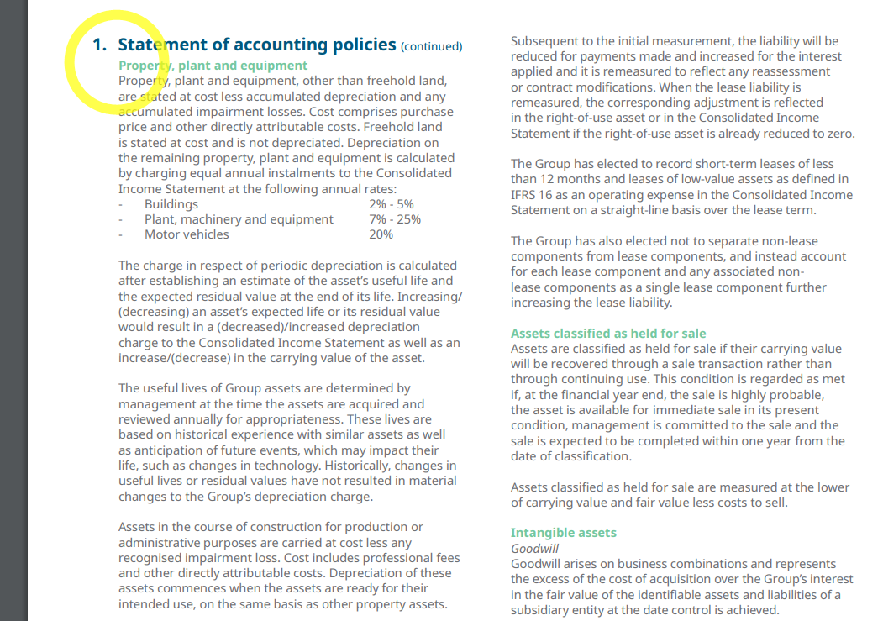
Note #1: Accounting Policies Note

Slide 9
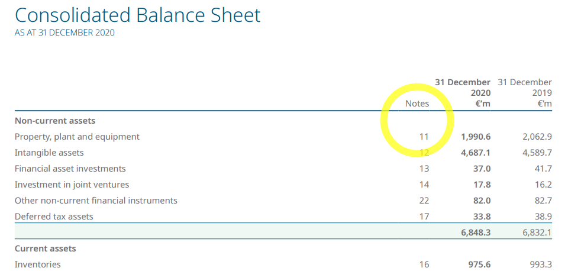
Note for each line item

Slide 10
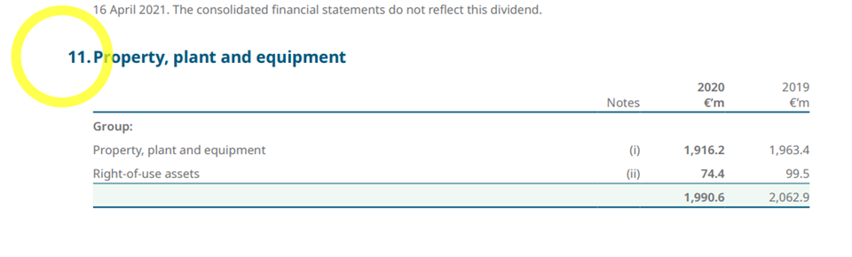
Note for each line item

Slide 11
Operating segments (IFRS 8)

Slide 12
Segmental information
Financial statements are aggregate figures for whole business
Business may consist of distinct components – with different risk profiles, growth rates, etc
Google vs Amazon
If you had to choose one, which one would you invest in today?
Let’s look at their income statements (remember: financial statements aggregate information for entire business)

Slide 13
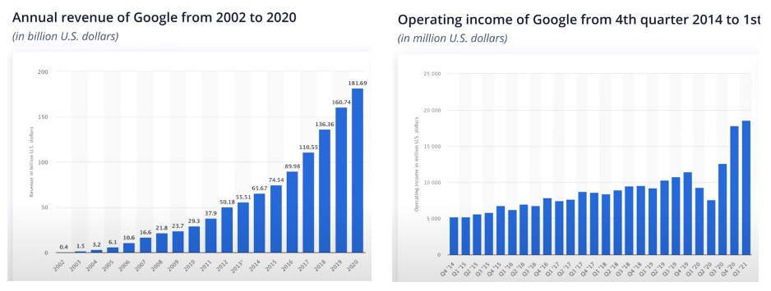
Google income statements

Slide 14
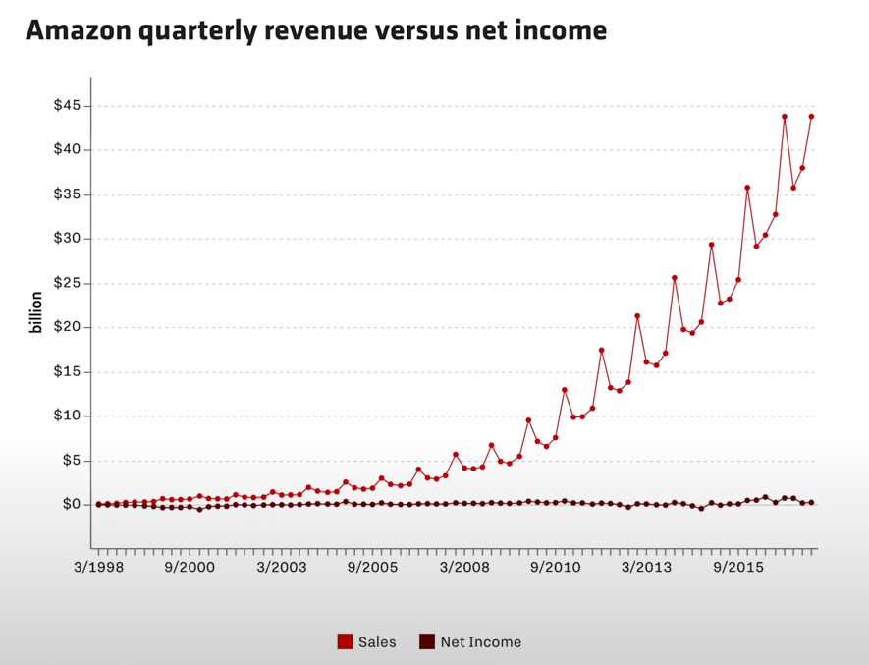
Amazon income statements

Slide 15
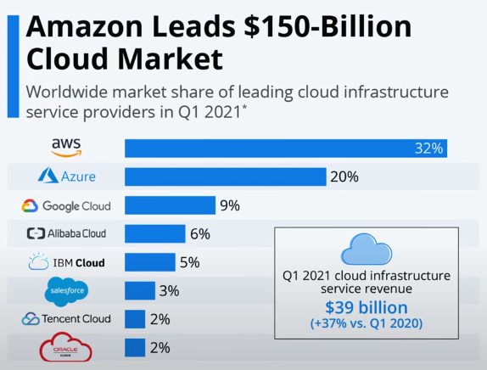
Innovation & Reinvestment
Previously we heard co-founder of Stripe saying accounting rules failed to capture value of intangible assets such as software
Expenditure on developing new projects expensed rather than capitalized
Deteriorates income statement / balance sheet / cash flow statement
How could this impact on the income statement (revenue / net profit) of Amazon & Google?

Slide 16
Innovation & Reinvestment
Amazon vs Google:
https://www.youtube.com/watch?v=9Fq15k9QPv8&list=PL91a1XTCKAC7DGcVG-LzpY3JoW0cThde_&index=4&t=365s
Watch: 6:05 - 8:53
Notes:
https://www.youtube.com/watch?v=9Fq15k9QPv8&list=PL91a1XTCKAC7DGcVG-LzpY3JoW0cThde_&index=4&t=365s

Slide 17
Segmental information
The examples of Google vs Amazon shows the importance of segmental information
To analyse businesses with distinct components (risk, growth, etc.) → you need more granular financial information
IFRS 8 is the accounting standard which regulates the preparation of segmental information that companies must disclose
Segmental information is disclosed in the Notes to the financial statements !
Let’s look at the accounting rules / requirements

Slide 18
IFRS 8: Operating Segments
IFRS 8 (Operating Segments) is a disclosure standard
Does not address how transactions should be accounted for
Only addresses how information should be disclosed
The objective of IFRS 8 is for the organisation
To disclose information to enable the users of its financial statements to evaluate the nature and financial effects of:
Types of business activities the entity engages in and
Economic environments the entity operates within

Slide 19
Definitions
‘Chief operating decision maker’
Term ‘chief operating decision maker’ is referred to in IFRS 8 (Operating Segments).
Not defined in standard
Refers to a function, rather than a title.
Function could be fulfilled by a group of directors rather than a single director.

Slide 20
Definitions
‘Operating segment’ – a component of an organisation
That engages in business activities from which it may earn revenues and incur expenses
Including revenue & expenses relating to transactions with other components of the same organisation
Whose operating results are reviewed regularly by the organisation’s ‘chief operating decision maker’ to make decisions about:
Resources to be allocated to the segment and
To assess its performance
For which discrete financial information is available.

Slide 21
Definitions
‘Reportable segment’:
An ‘operating segment’ or aggregations of ‘operating segments’ that meet size criteria specified in IFRS 8 (Operating Segments)

Slide 22
Identifying ‘operating segments’
Not all of the operations of an organisation will necessarily be an operating segment
For example, corporate headquarters does not have sufficient economic substance:
it does not earn revenue or only earns revenue that is incidental to the activities of the organisation

Slide 23
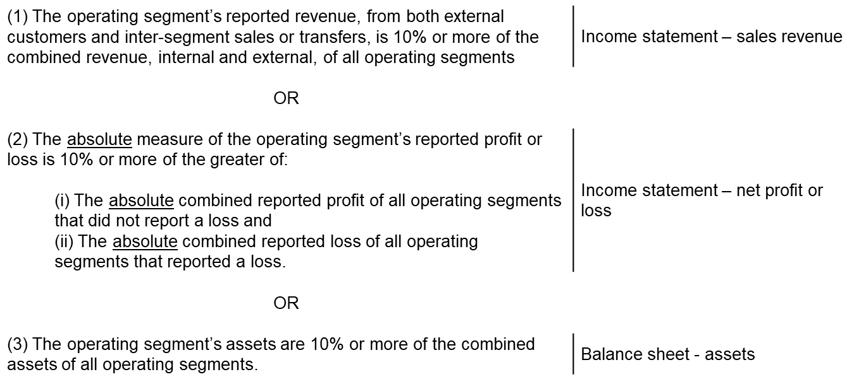
Reportable Segments
Company must report financial & descriptive information about its ‘reportable segments’.
‘Reportable segments’ are ‘operating segments’, or aggregations of ‘operating segments’, that meet specified size criteria:

Slide 24
75% threshold for sales revenue
If total external revenue reported by reportable segments is less than 75% of the organisation’s revenue:
Additional operating segments must be identified as reportable segments – even if they do not meet the size criteria for a ‘reportable segment’
Additional reportable segments must be added until at least 75% of the organisation’s revenue is included in the reportable segments

Slide 25
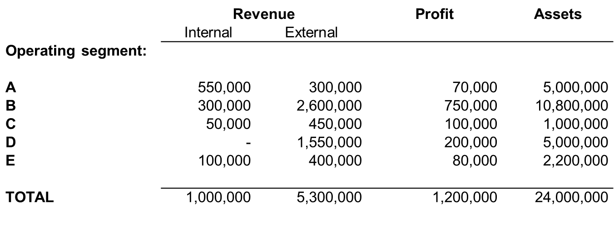
Example: Reportable Segments
P Ltd is a listed company. The following operating segments have been identified in the company:
Question:
Apply the principles in IFRS 8 (Operating Segments) to determine P Ltd’s reportable segments.

Slide 26
Example: Reportable Segments
Let’s consider IFRS 8’s size criteria for ‘reportable segments’:

Slide 27
Segment reporting
IFRS 8 (Operating Segments) does not define:
Segment revenue
Segment expense
Segment result
Segment assets or
Segment liabilities
Standard only requires an explanation of how segment profit or loss, segment assets and segment liabilities are measured for each operating segment
Therefore, organisations are provided with the discretion to determine what is included in segment profit or loss
But in practice, organisations will be limited by their internal reporting practices.

Slide 28
Related party disclosures (IAS 24)

Slide 29
IAS24 – Related Party Disclosures
IAS24 is a disclosure standard
Disclosures made in Notes to the financial statements
It is important that a user be aware of parties with whom the entity is related
And of transactions that have taken place with those parties during the reporting period
Users need to know if the figures in the financial statements do not reflect arm’s length transactions between independent parties

Slide 30
Example
If a subsidiary, its policies and decision-making powers are effectively controlled by its parent company
An awareness of the parent-subsidiary relationship is an important disclosure that should be made in both companies’ financial statements

Slide 31
Example
An entity may extend a loan to one of its directors at a discounted interest rate
Disclosure of this transaction is important if the information provided in the financial statements is to be considered as complete

Slide 32
Objective of IAS24
Objective of IAS24 is to draw attention to the possibility that financial statements may have been affected by:
existence of related parties &
by material transactions & outstanding balances with such parties

Slide 33
What is a related party transaction?
A related party transaction is a transfer of resources, services, or obligations between related parties, regardless of whether a price is charged
The following are examples of transactions that are disclosed if they are with a related party:
Purchases or sales of goods
Purchases or sales of property & other assets
Rendering or receiving of services
Leases
Transfers of research and development

Slide 34
Who are related parties?
An entity is related to a reporting entity if any of the following applies:
Both entities are members of the same group
thus, a parent and a subsidiary are related parties, as are fellow subsidiaries
One entity is an associate or joint venture of the other
One entity is an associate or joint venture of a company in a group of which the other entity is a member

Slide 35
Who are related parties?
(a)…cont’d
Both entities are joint ventures of the same third party
One entity is a joint venture of a third entity, and the other entity is an associate of the third entity
The entity is a post-employment benefit plan for the benefit of employees of the entity, or of any entity that is a related party of the entity
The entity is controlled or jointly controlled by a person identified in the next slide

Slide 36
Who are related parties?
(b) A person, or a close family member of the person, is related to a reporting entity if that person:
Has control or joint control over the reporting entity
Has significant influence over the reporting entity or
Is a member of the key management personnel of the reporting entity or its parent.

Slide 37
Definition
Key Management Personnel
those persons having authority and responsibility for planning, directing and controlling the activities of the entity, directly or indirectly, including all directors (executive and non-executive)

Slide 38
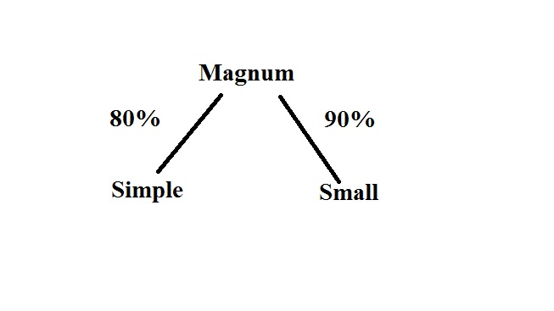
Example 1: Parent & Subsidiaries
Magnum Limited controls two subsidiaries: Simple Limited and Small Limited

Slide 39
Example 2: Member of Key Management Personnel
On 1 December 2020, Magnum Limited extends a loan of €200,000 to Roy Scapens, who is a brother of Magnum director, Tom Scapens

Slide 40
Example 3: Customer
During 2020, Magnum Limited sold a large quantity of goods to Brice Limited
Neither company holds shares in the other

Slide 41
The following are NOT related parties
Two enterprises simply because they have a director or key manager in common
Two venturers who share joint control over a joint venture
Providers of finance, trade unions, public utilities, and government departments & agencies in the course of their normal dealings with an enterprise
A customer, supplier, franchisor, distributor, or general agent, simply because they transact a significant volume of business with such a party

Slide 42
Disclosure
Related Party Transactions
If there has been material transactions between related parties, an entity must disclose separately, for each category of related parties, the info for an understanding of potential effect of transaction on financial statements
This will include:
The nature of the related party relationship
The amount of the transactions
The amount of outstanding balances, including commitments
Provisions for doubtful debts related to the amount of the outstanding balances
The expense recognized during the period in respect of bad or doubtful debts due from related parties

Slide 43
Disclosure
Relationships between parents and subsidiaries
Irrespective of whether there have been any transactions between a parent and a subsidiary, an entity must disclose:
Name of its parent and
Name of ultimate controlling party (if different)
If neither the parent, nor the ultimate controlling party produces financial statements available for public use, disclose name of next most senior parent that does produce public financial statements.

Slide 44
Disclosure
Management Compensation
Disclose key management personnel compensation in total and for each of the following categories:
Short-term employee benefits
Post-employment benefits
Other long-term benefits
Termination benefits, and
Share-based payment

